Slide 1
SYNCHORNIZATION
Logical Clocks

Slide 2
Logical Clocks
For many algorithms, associating an event to an absolute “real time” is not essential
  What’s important is that processes agree on the ordering of events
  “relative time” is not the same as “real time”.
Relative time measured by Logical Clocks
  Lamport's timestamps
  Vector timestamps

Slide 3
Lamport’s Logical Clocks
Lamport clocks define a relation called "happens-before"
“happens before” relation denoted as →
The relation can be observed in two situations:
  If a and b are events in the same process, and a occurs before b, then a → b
  If a is the action of sending a message, and b is the event of receiving that message, then a → b

Slide 4
“Happens Before” Relation
The “happens before” relation is transitive
  a → b and b → c then a → c
If two events e1 and e2 happen in different processes that do not exchange messages, then
  e1 → e2 is not true
  e1 and e2 are concurrent
  No information about the order of these events

Slide 5
Concurrent Events
If two events happen without any message, then we can't say anything about their relative occurrence in time.
We can say that a → b → c → d → f, but we can say little about e other than e → f.
a
b
P₁
m₁
c
d
P₂
m₂
e
f
P₃

Slide 6
Lamport Logical Clocks
Measuring “time”
  Each event is assigned a time value
    e_{i} → e_{j} ⇒ LC(e_{i}) < LC(e_{j})
  LC_{i} is a local clock and contains increasing values
    Each process has its own LC
    Increment LC on each event occurrence
  Within same process i, if e_{j} occurs before e_{k}
    LC_{i}(e_{j}) < LC_{i}(e_{k})
  If e_{s} is a send event and e_{r} a receive event, then
    LC_{i}(e_{s}) < LC_{j}(e_{r})

Slide 7
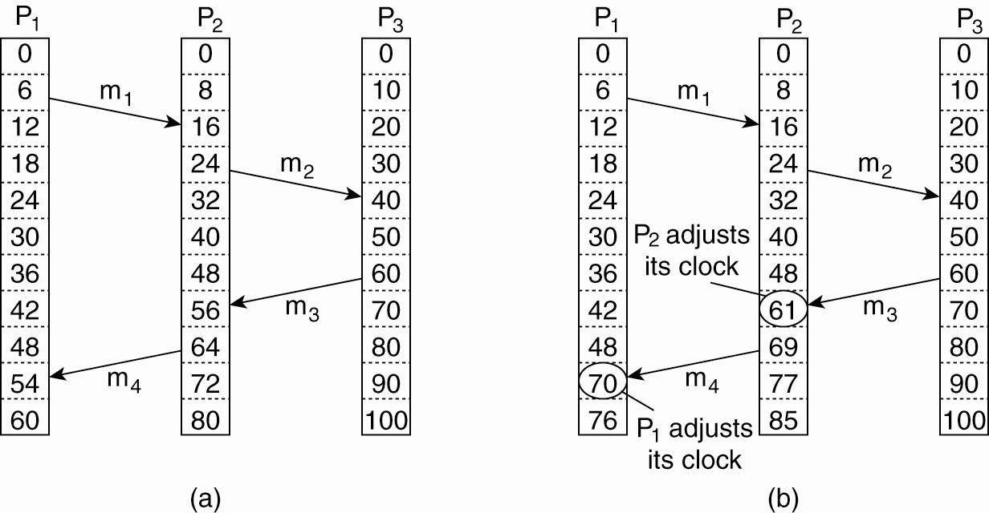
Lamport’s Logical Clocks
Three processes, each with its own clock.
  The clocks run at different rates.
Message m₃ arrives before it was sent!

Slide 8
Logical Clocks – Readjusting
Lamport’s algorithm corrects the clocks.

Slide 9
Lamport’s Logical Clocks
To implement Lamport’s algorithm, each process, P_{i}, maintains a local counter, C_{i}
Updating counter C_{i} for process P_{i}
Before executing an event P_{i} executes C_{i} = C_{i} + 1.
When process P_{i} sends a message m to P_{j}, it sets m’s timestamp ts (m) equal to C_{i} after having executed the previous step.
Upon the receipt of a message m, process P_{j} adjusts its own local counter as C_{j} = max{C_{j} , ts (m)}, after which it then executes the first step and delivers the message to the application.

Slide 10
Limitation of Lamport’s Algorithm
e_{i} → e_{j} ⇒ LC(e_{i}) < LC(e_{j})
However, LC(e_{i}) < LC(e_{j}) does not imply e_{i} → e_{j}
  For example, (1,1) < (1,3), but events a and e are concurrent
a
b
Real Time
P₁
(1,1)
(2,1)
m₁
c
d
P₂
(3,2)
(4,2)
m₂
e
g
f
P₃
(1,3)
(2,3)
(5,3)

Slide 11
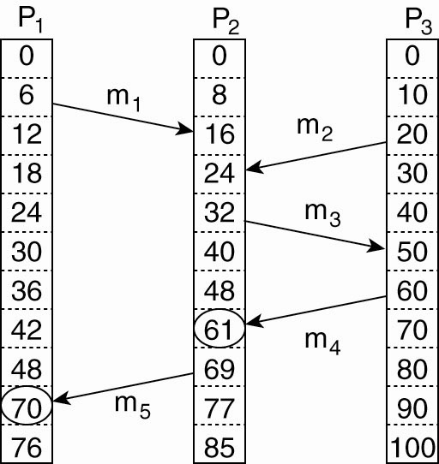
Vector Clocks (1)
Lamport clocks do not capture causality
  Sending m3 may have depended on m1
Causality can be captured by Vector Clocks

Slide 12
Vector Clocks (2)
Each process and message stores a vector of clock values
  Each process stores the last value seen of every other process’ clock
  Processes send their vector with each message
A vector VC_{i} with the following two properties:
  VC_{i} [ i ] is the number of events that have occurred so far at P_{i}.
    VC_{i} [ i ] is the local logical clock at process P_{i} .
  If VC_{i} [ j ] = k then P_{i} knows that k events have occurred at P_{j}.
    P_{i}’s knowledge of the local time at P_{j}

Slide 13
Vector Clocks – Basic Steps
Steps carried out to accomplish property 2:
  Before executing an event P_{i} executes
  VC_{i} [ i ] ← VC_{i} [i ] + 1.
  When process P_{i} sends a message m to P_{j}, it sets m’s (vector) timestamp ts (m) equal to VC_{i} after having executed the previous step.
  Upon the receipt of a message m, process P_{j} adjusts its own vector by setting
  VC_{j} [k ] ← max{VC_{j} [k ], ts (m)[k ]} for each k, after which it executes the first step and delivers the message to the application.

Slide 14
Vector Clocks –Local Events
Initialization
  The vector timestamp for each process is initialized to (0,0,…,0)
Local Event
  When an event occurs on process P_{i}:
    VT_{i}[i] ← VT_{i}[i] + 1
    For example on processor 3, (1,2,1,3) → (1,2,2,3)

Slide 15
Vector Clocks – Messages
Message Passing
  When P_{i} sends a message to P_{j}, the message has timestamp t[]=VT_{i}[]
  When P_{j} receives the message, it sets VT_{j}[k] to max(VT_{j}[k], t[k]), for k = 1, 2, …, N
    For example, P₂ receives a message with timestamp (3,2,4) and P₂’s timestamp is (3,4,3), then P₂ adjusts its timestamp to (3,4,4)

Slide 16
Comparing Clock Vectors
VT₁ = VT₂ iff VT₁[i] = VT₂[i] for all i
VT₁ ≤ VT₂ iff VT₁[i] ≤ VT₂[i] for all i
VT₁ < VT₂ iff VT₁ ≤ VT₂ & VT₁ ≠ VT₂
  For example, (1, 2, 2) < (1, 3, 2)

Slide 17
Vector Clocks Analysis
Claim – e → e’ iff e.VT < e’.VT
a
b
[2,0,0]
Real Time
P₁
[1,0,0]
m₁
c
d
[2,2,0]
P₂
[2,1,0]
m₂
e
g
f
[2,2,3]
P₃
[0,0,1]
[0,0,2]

